Slide 1
An Opinionated Approach to ASP.NET Core
(50 opinions, to be exact)
K. Scott Allen
@OdeToCode

Slide 2
Solutions and Projects
Controllers
C# Code
Views
Startup
Client Code
Tests

Slide 3

Solutions & Projects
3

Slide 4
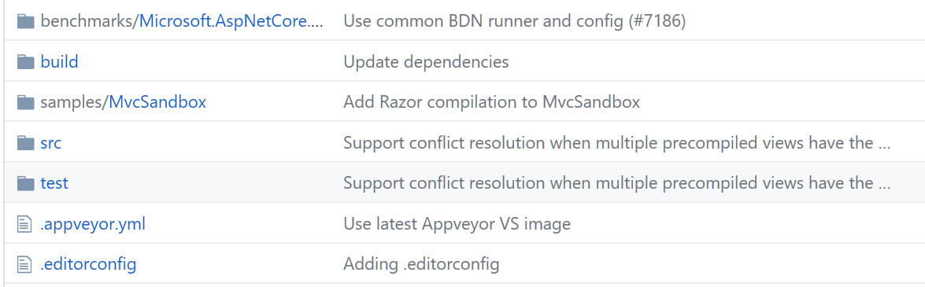
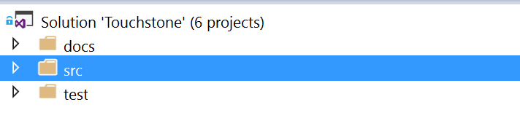
Use a Standard Repo Structure

Slide 5
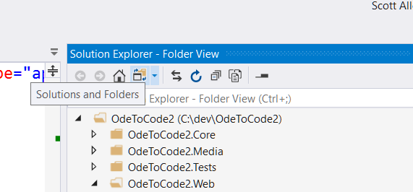
Use Folder View

Slide 6
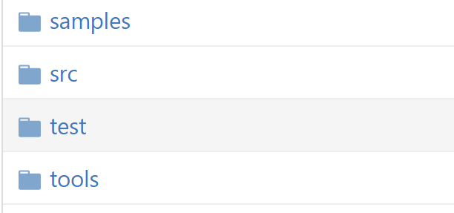
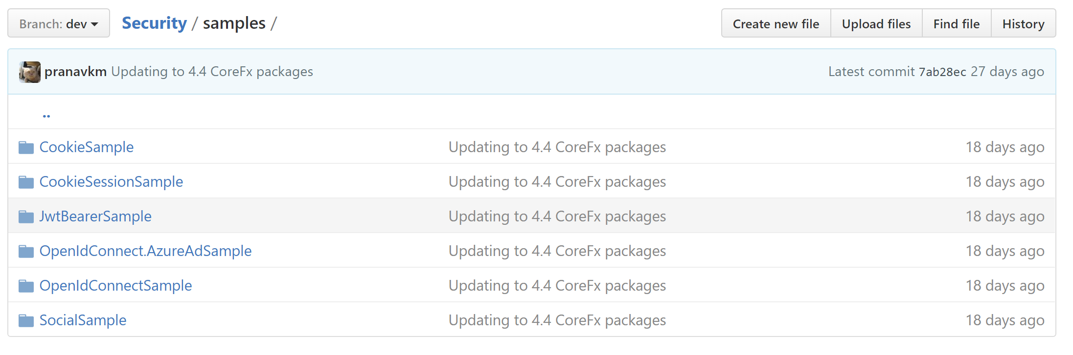
Include Samples & Tools

Slide 7
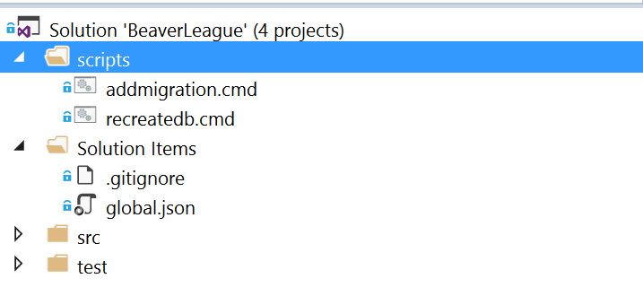
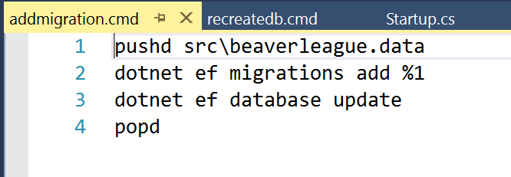
Include Development Scripts

Slide 8
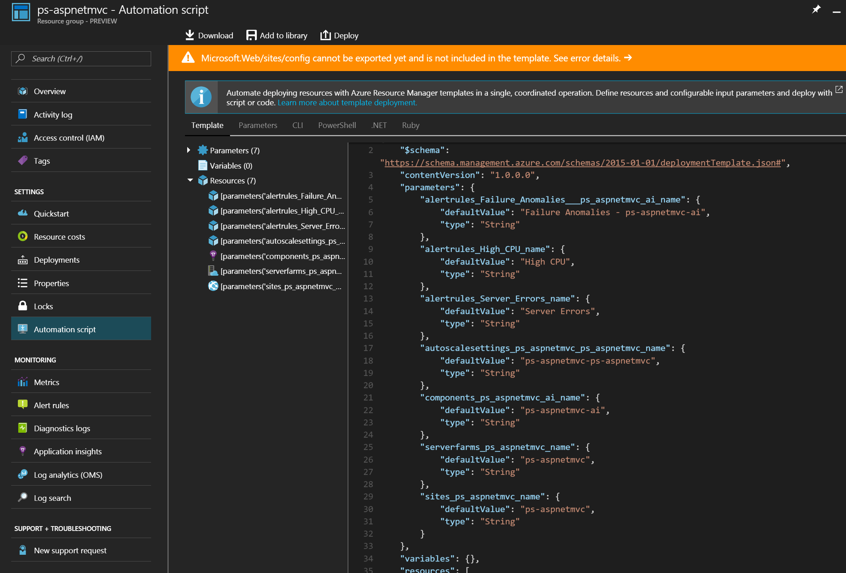
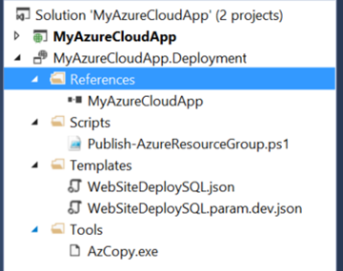
Include Deployment Scripts & Templates

Slide 9
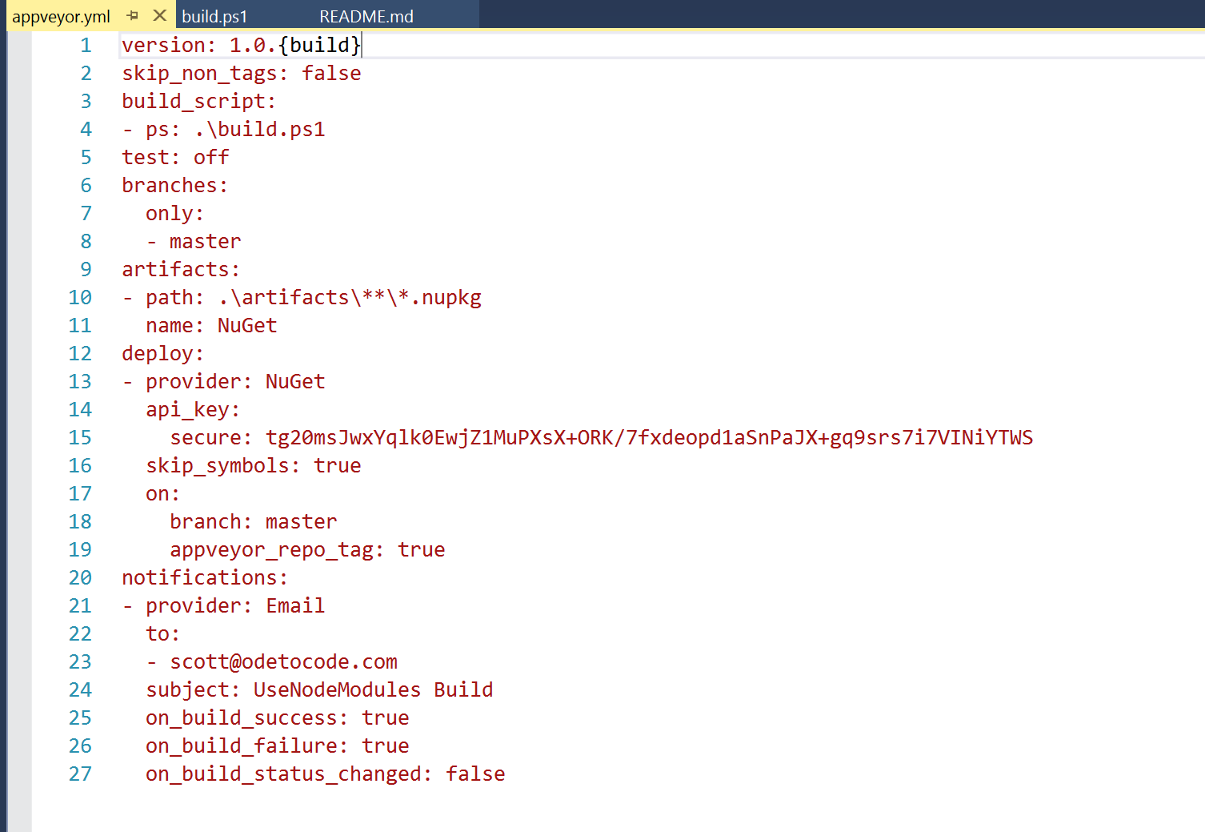
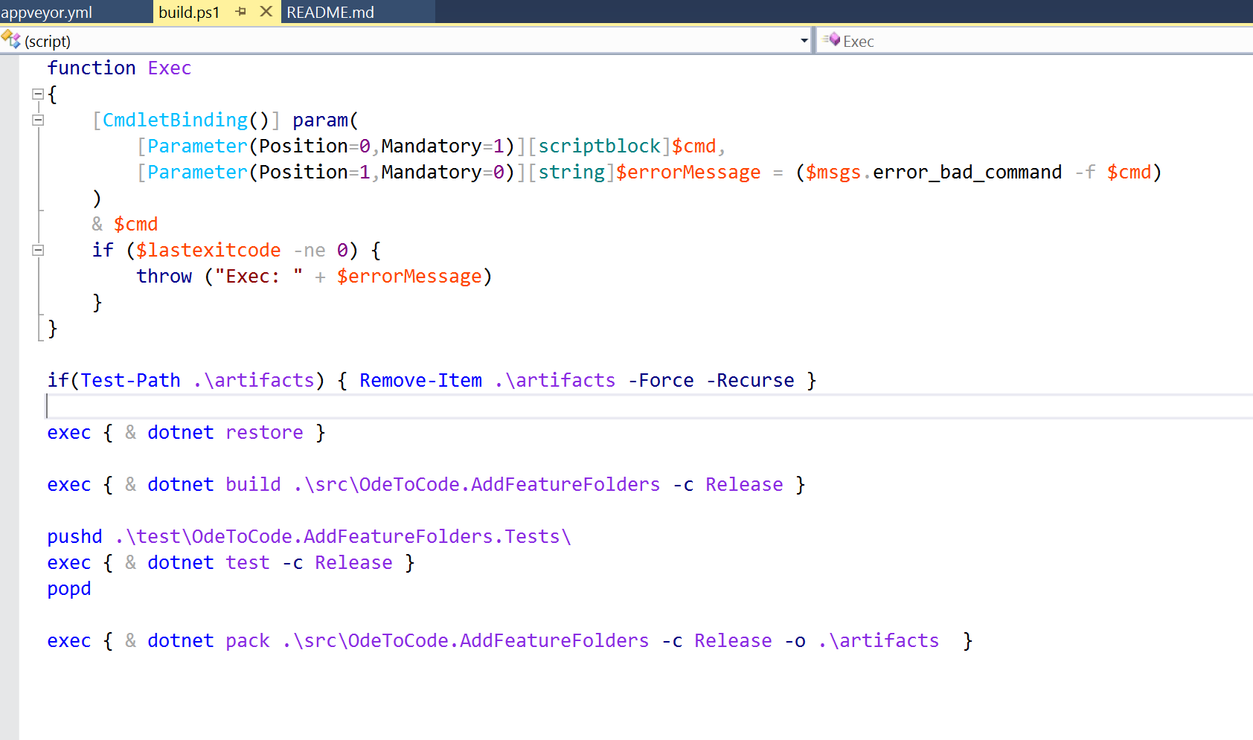
Use AppVeyor YAML for Builds Instead of UI

Slide 10
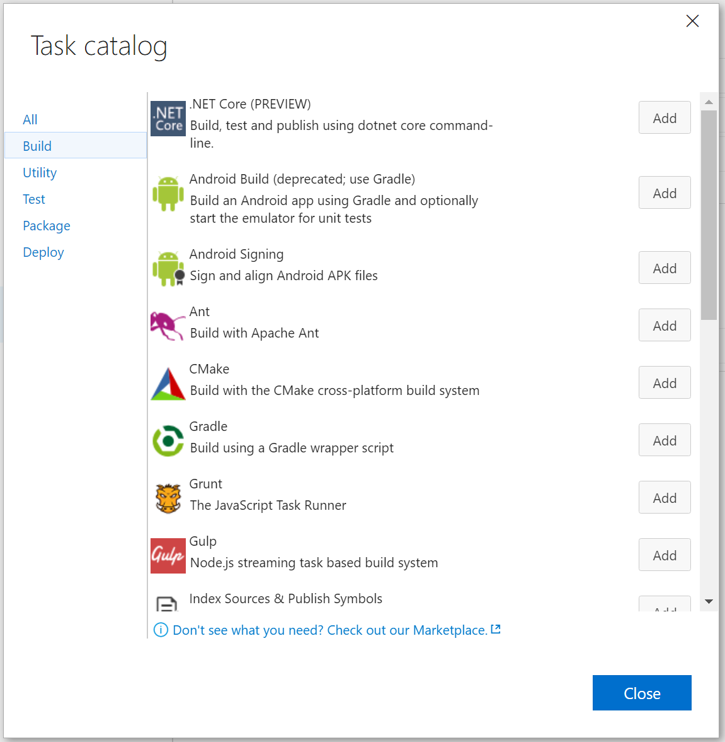
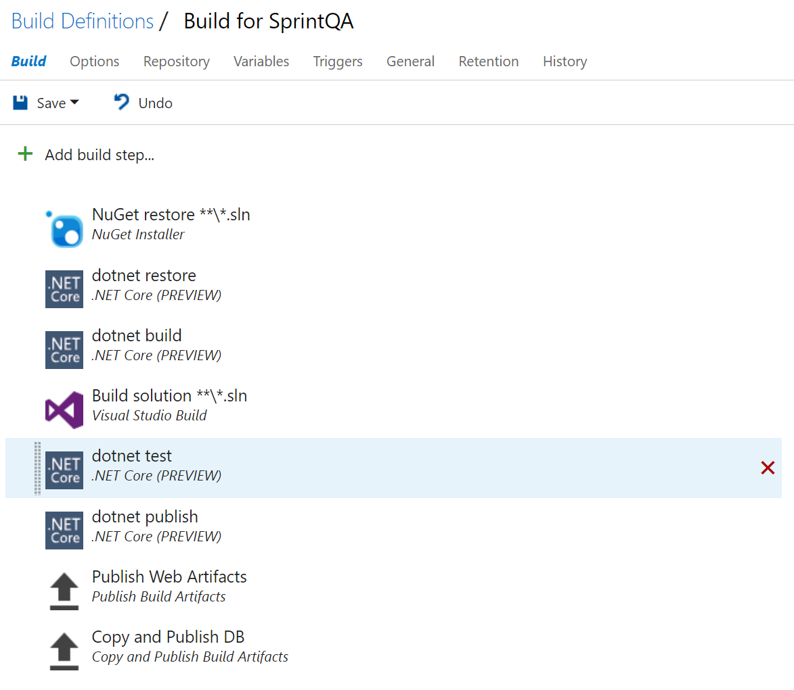

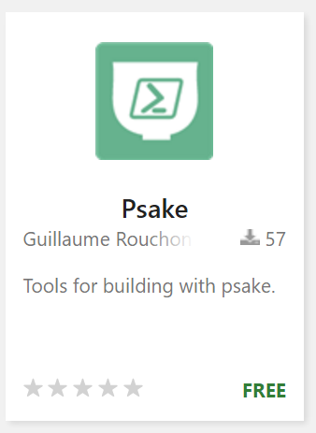
Use Scripts for VS Online Builds

Slide 11

Startup
11

Slide 12
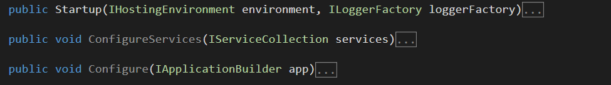
Only Use Startup for Services and Middleware
Three responsibilities

Slide 13
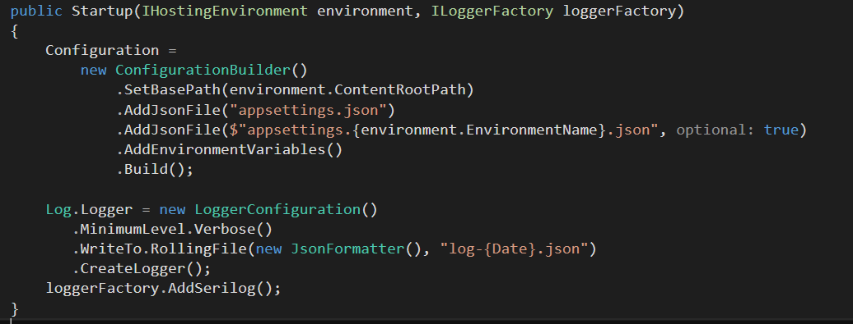
Logger Is Configured Before Middleware
Leave Configure for middleware only

Slide 14
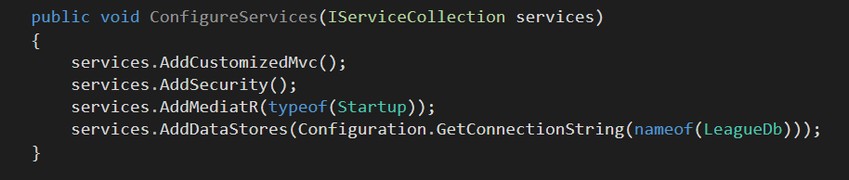
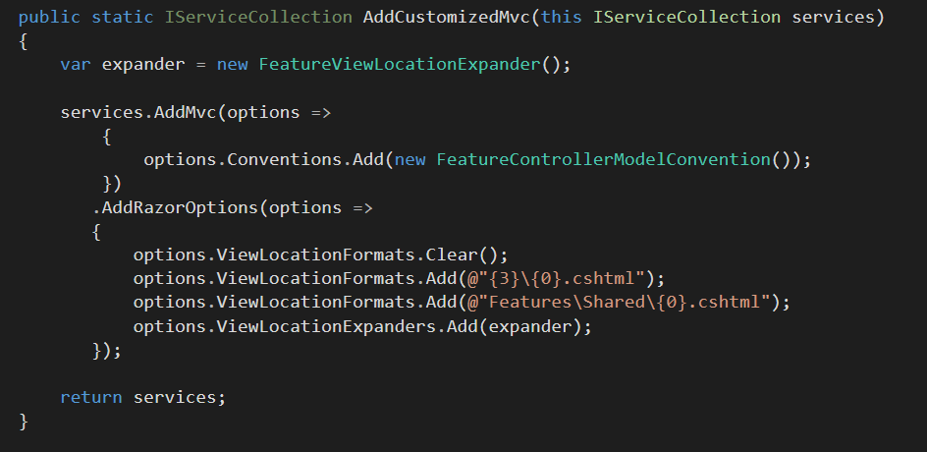
Keep Configure Methods Clean

Slide 15
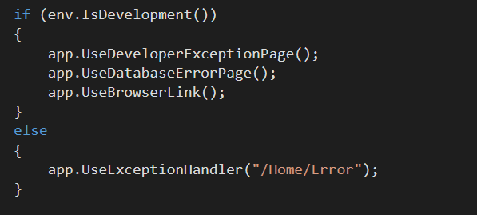
Configure Is Allowed To Branch

Slide 16
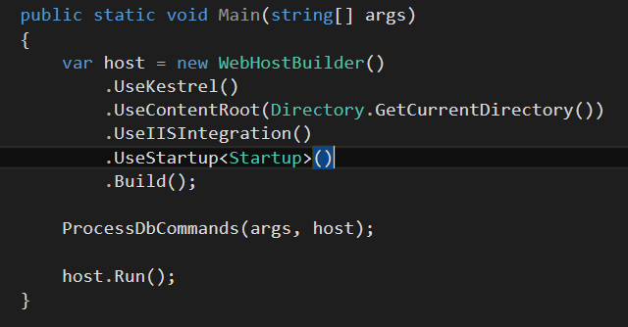
Make Use Of Your App As Executable

Slide 17
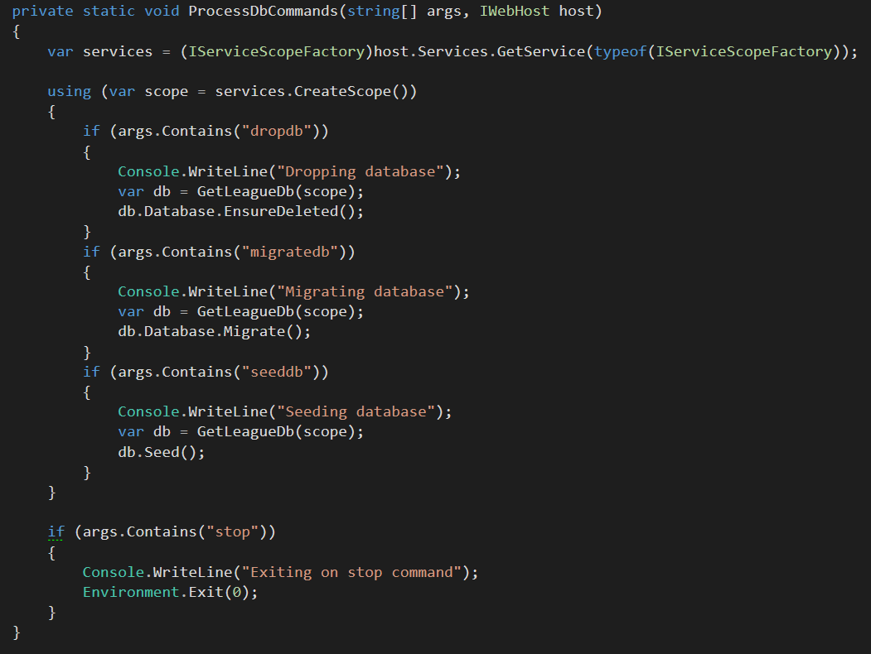
Always Use IServiceScopeFactory During Startup

Slide 18
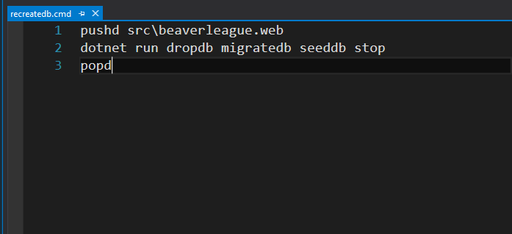
Add Scripts To Make Startup Parameters Easy

Slide 19

Project
Structure
21

Slide 20
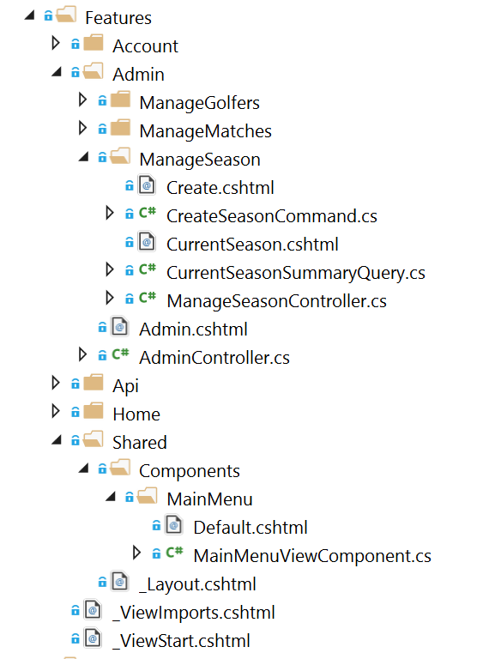
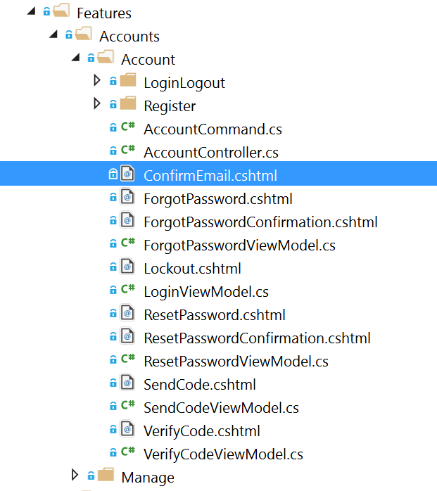
Feature Folders

Slide 21
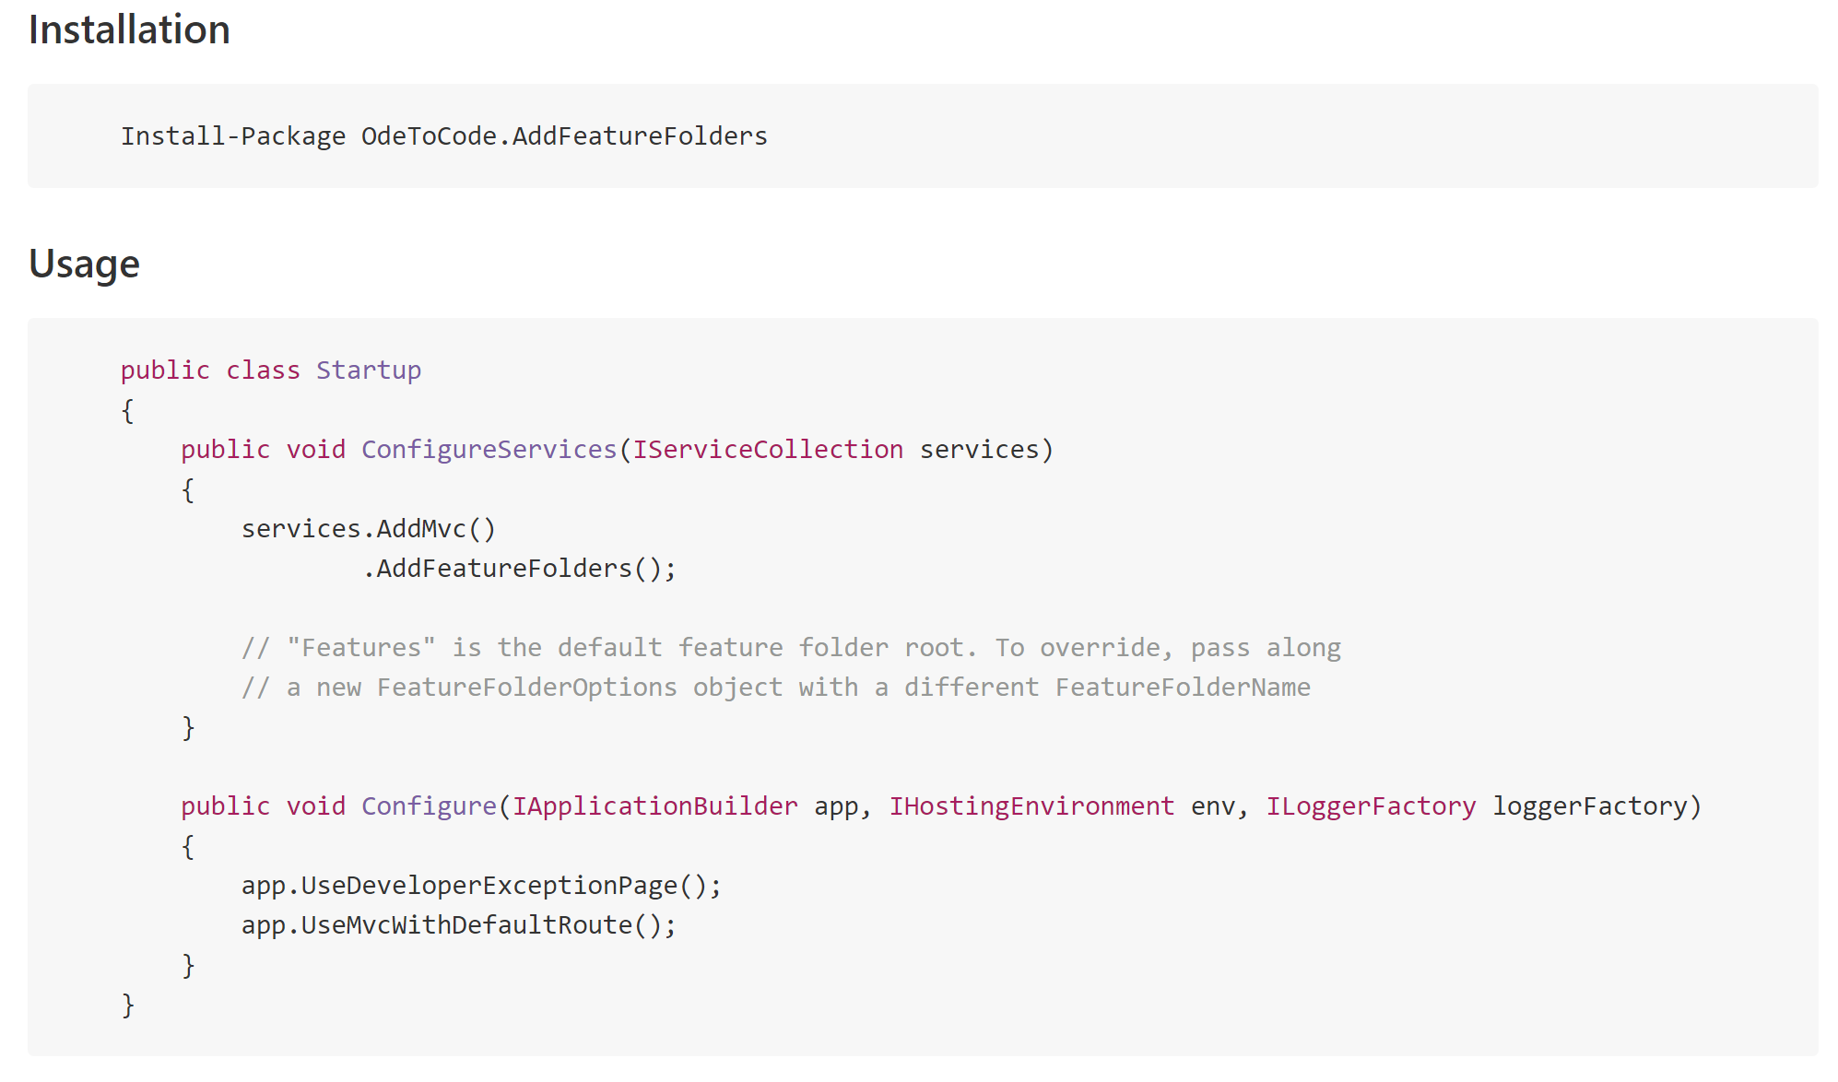
Feature Folders Are Easy

Slide 22
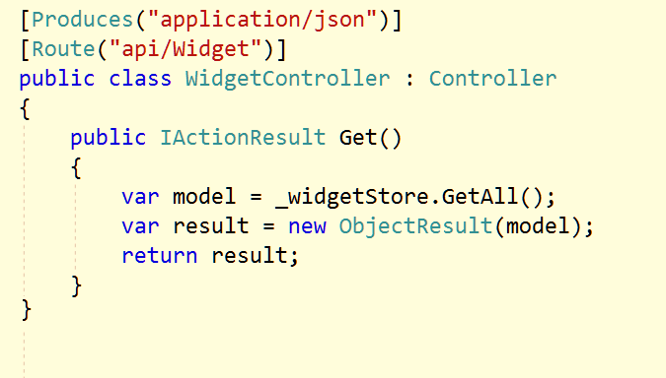
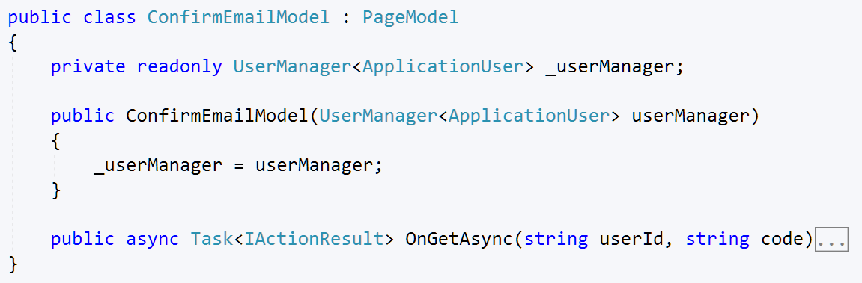
Controllers for APIs / Razor Pages for HTML

Slide 23
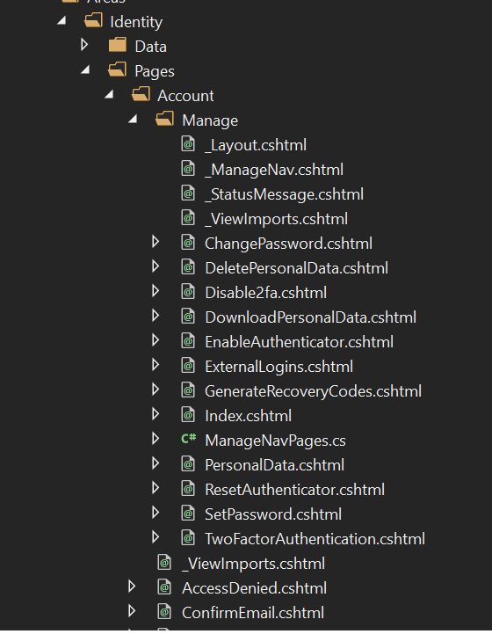
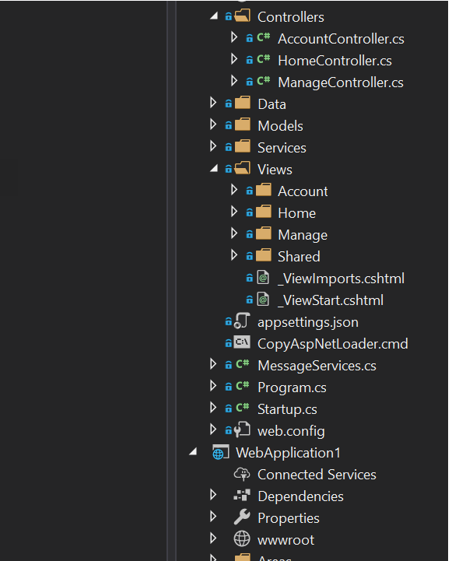
Identity Razor Pages
Identity MVC

Slide 24

Controllers
24

Slide 25
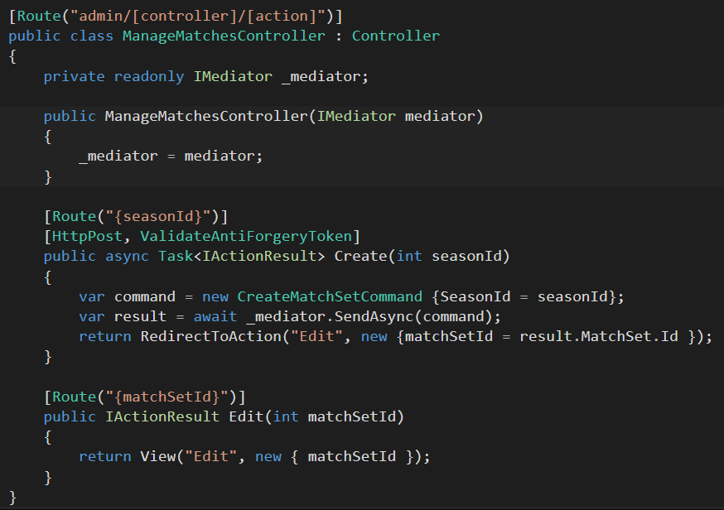
Route using [Route]

Slide 26
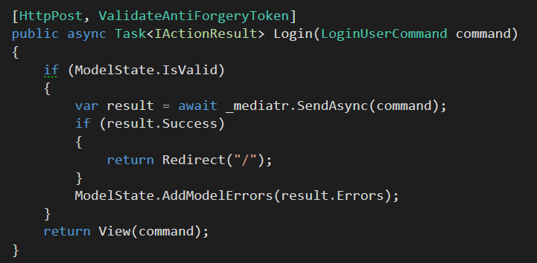
Think About Mediatr

Slide 27
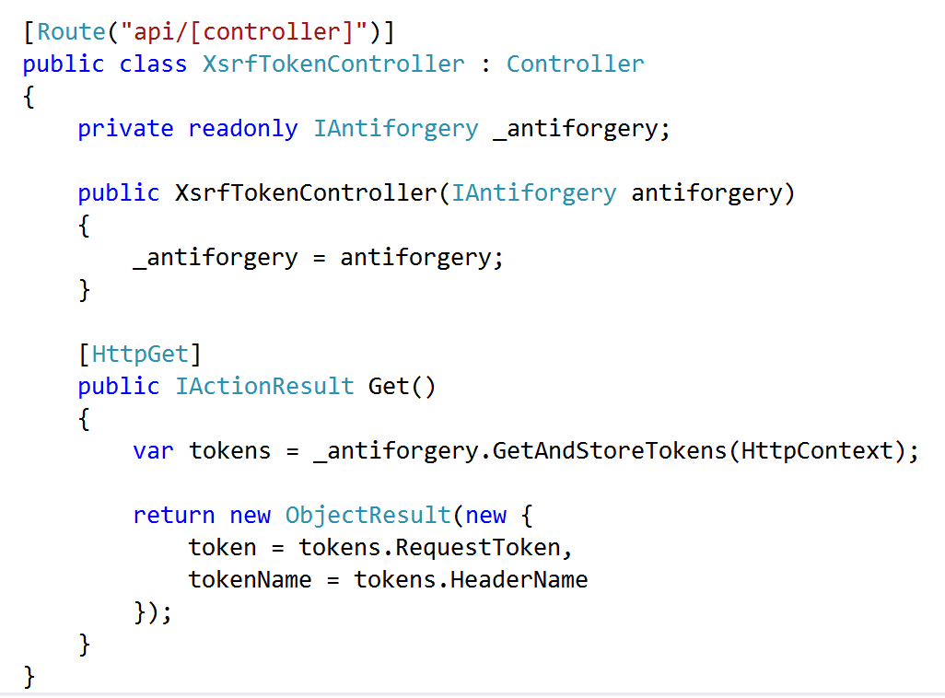
Don’t Forget XSRF in APIs

Slide 28
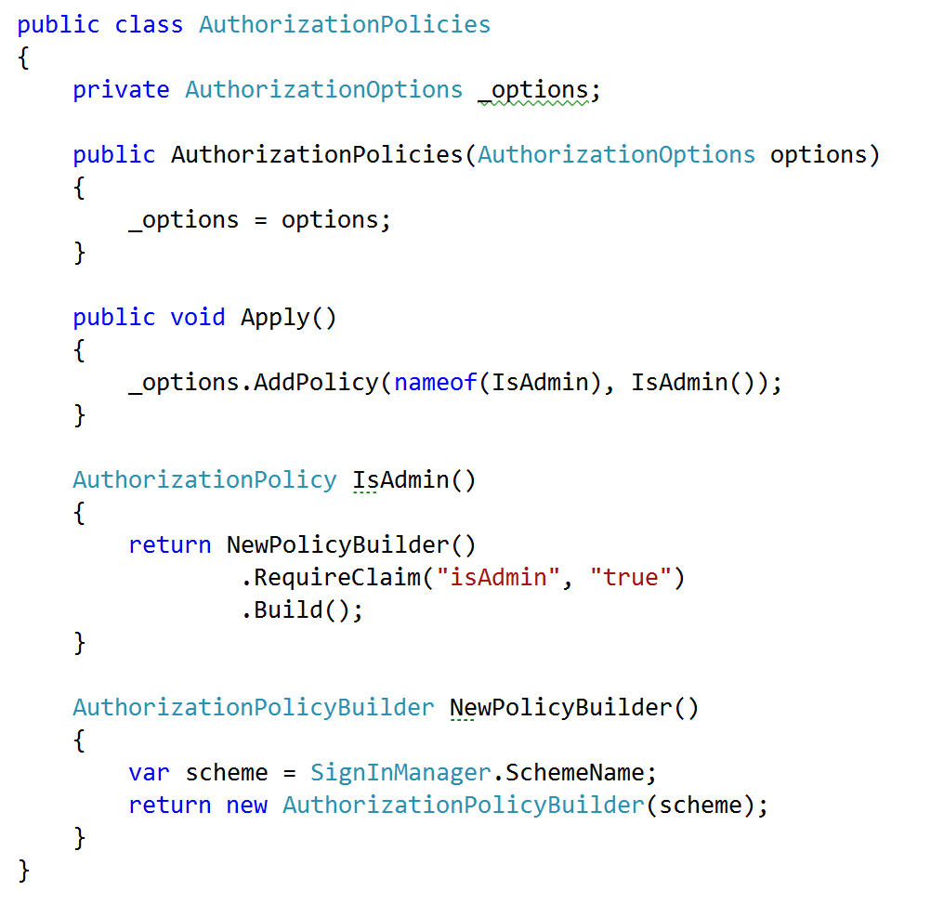
Embrace Security Policies

Slide 29
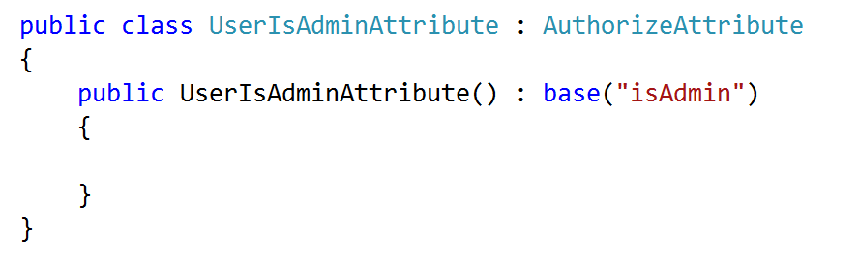
Create Custom Authorize Attributes

Slide 30

Views
32

Slide 31
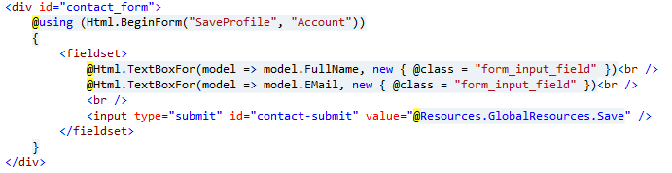
Avoid HTML Helpers

Slide 32
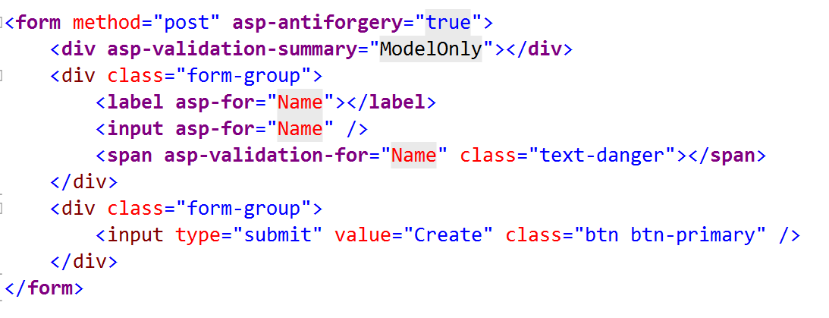
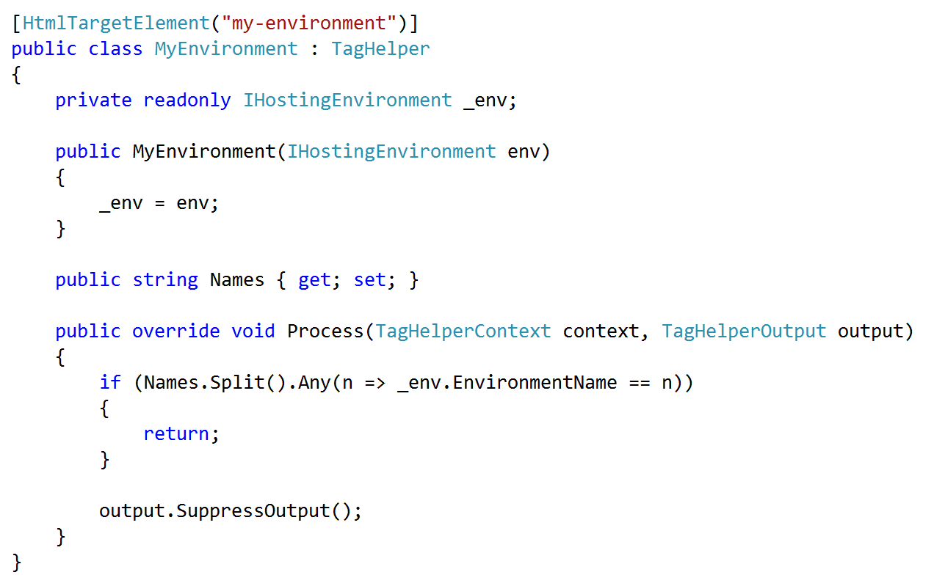
Embrace & Extend Tag Helpers

Slide 33
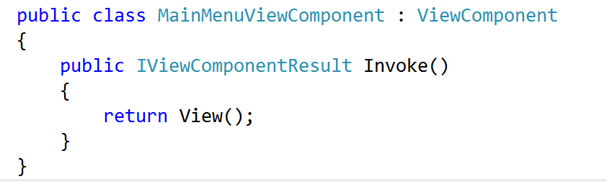
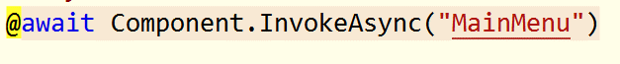
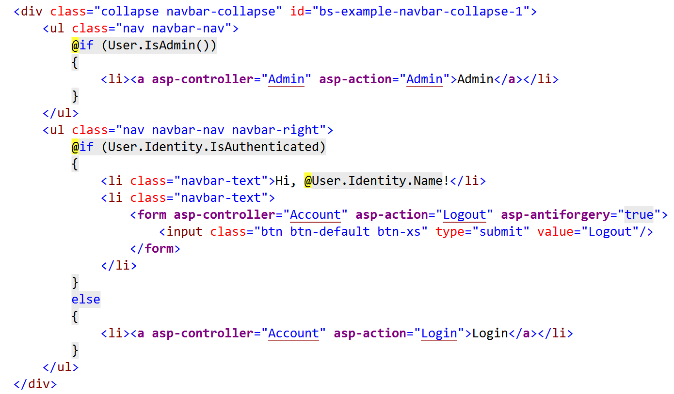
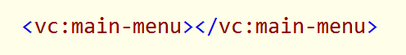
Embrace View Components

Slide 34

Client Code
36

Slide 35
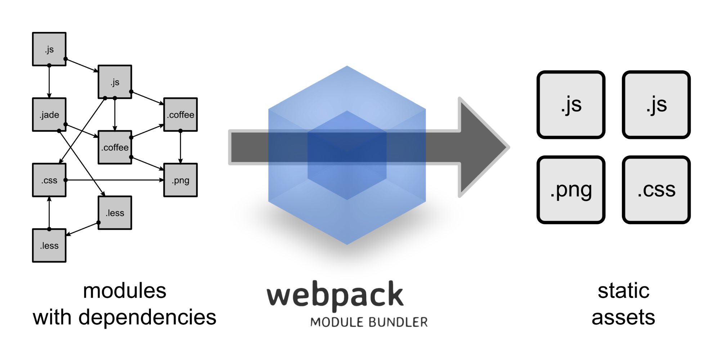
Use WebPack

Slide 36
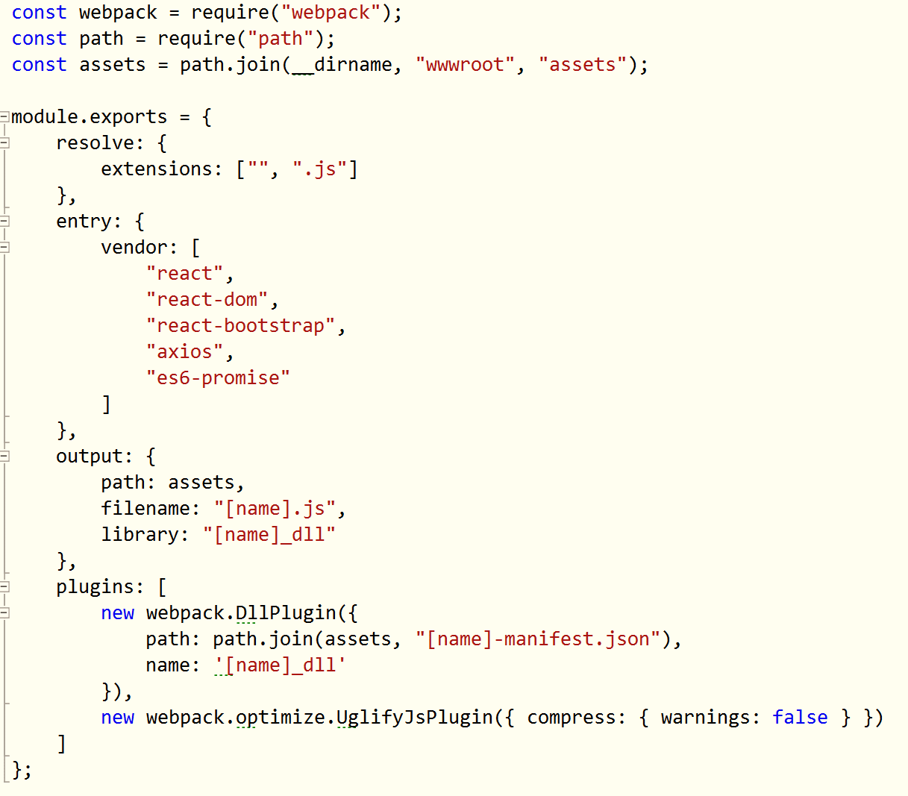
Use WebPack

Slide 37
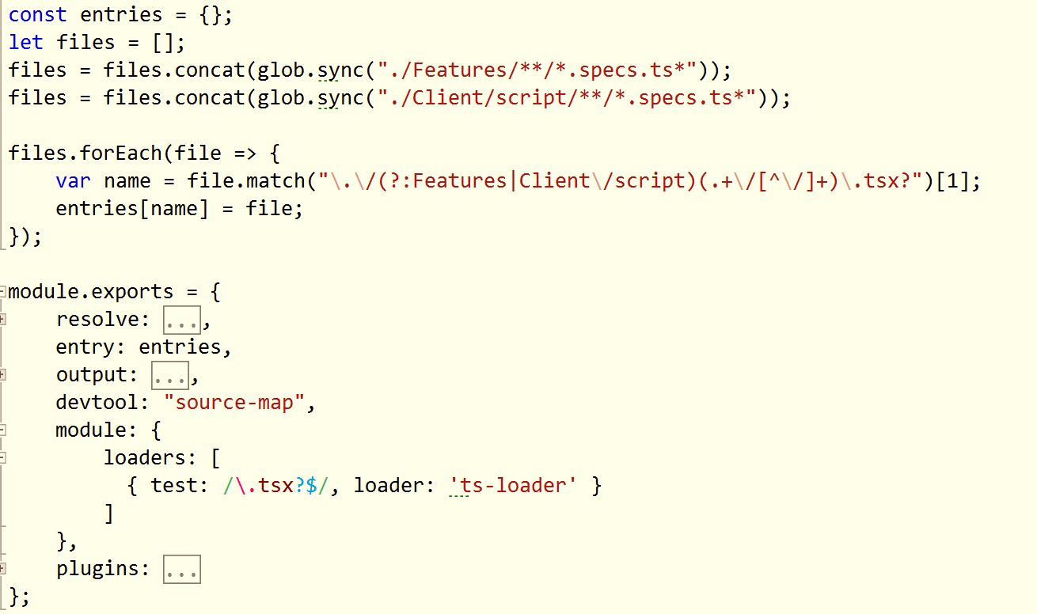
Use Multiple Configuration Files

Slide 38
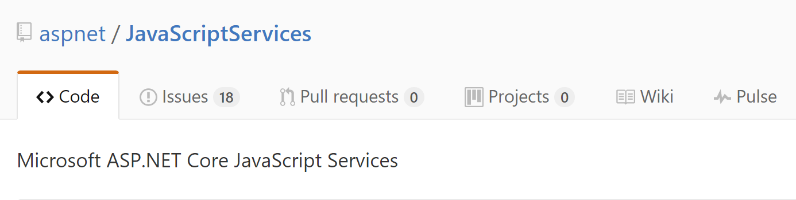
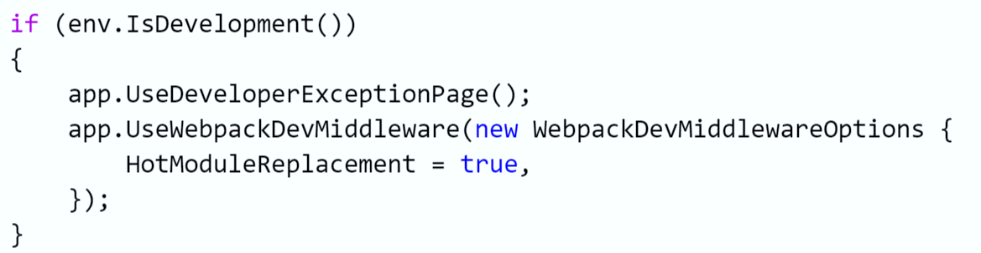
Use JavaScriptServices

Slide 39
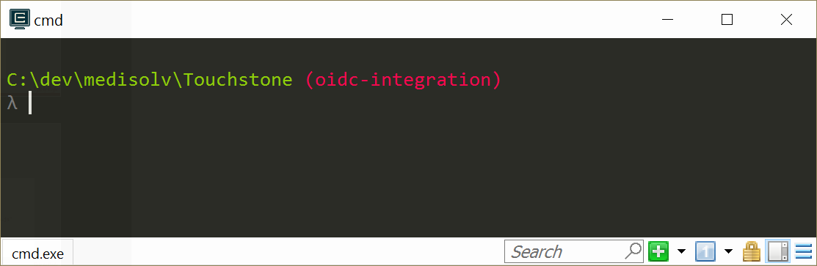
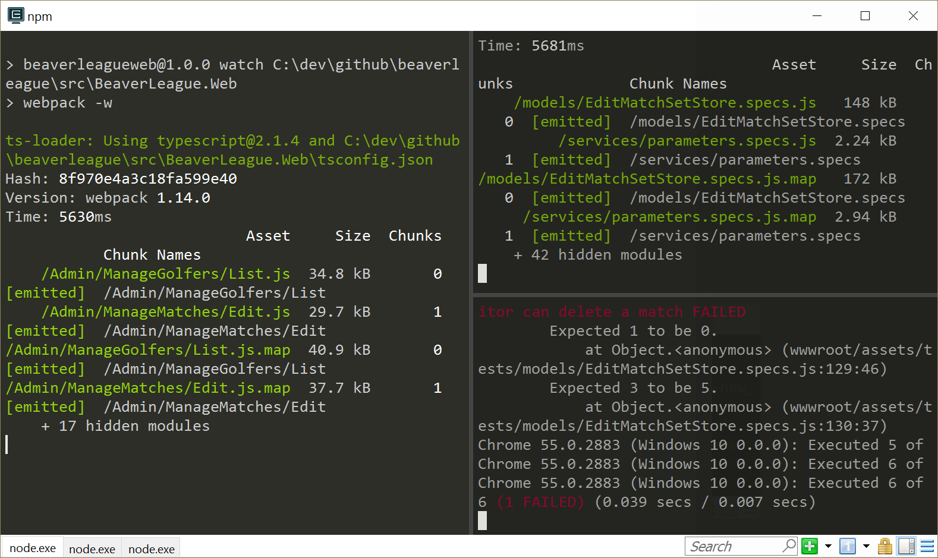
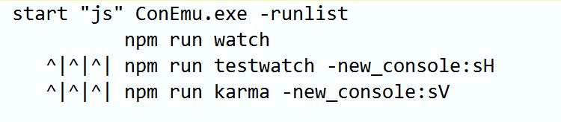
Use ConEmu or cmder

Slide 40
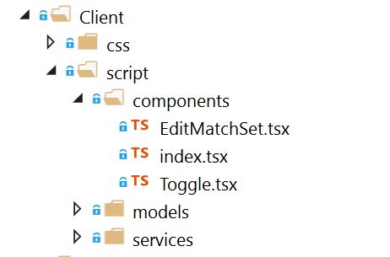

Client Code Layout

Slide 41

NuGet and npm Only

Slide 42


Use TypeScript

Slide 43

Use Visual Studio Code for TypeScript and ES2015+

Slide 44

wwwroot is your bin\ folder

Slide 45

Testing
50

Slide 46
A Single Test Project Is Not A Bad Idea
Web
Test
-
Web
Core
BEE
Core
BEE
(background
execution engine)

Slide 47


Use xUnit
Extensible, flexible, open source
Low ceremony
Good vocabulary

Slide 48







Try Hard to Avoid Mocks

Slide 49



Use the ASP.NET Core Test Host

Slide 50

Use the EF Core In-Memory Provider

Slide 51

Use the EF Core In-Memory Provider

Slide 52

More Integration Tests & Fewer Unit Tests

Slide 53

C#
Code
58

Slide 54

Use Environment.NewLine

Slide 55

Use Path.Combine

Slide 56

Be Aware of Environment Variables

Slide 57


Don’t Use the Async Suffix

Slide 58



Thanks!
scott@OdeToCode.com

